Slide 1
Software Architecture Project
Prepared by: Seid abrar

Slide 2
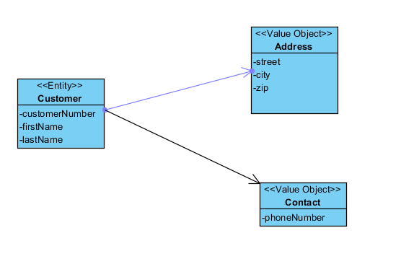
Class diagrams for Customer service

Slide 3
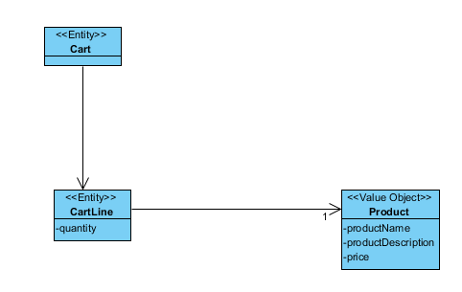
Class Diagram for Shopping Cart Query Service

Slide 4
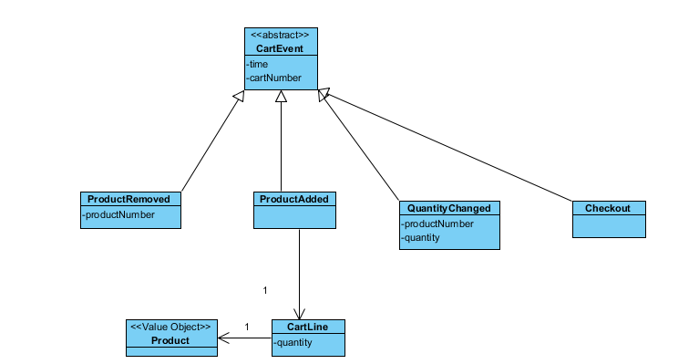
Class diagram for Shopping cart Command Service

Slide 5
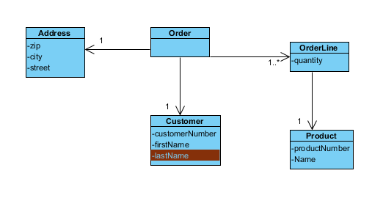
Class Diagram for order

Slide 6
Architectural Diagram

Slide 7
Thank you

